Slide 1

Unlocking Growth Potential:
Indian Institute Of Technology, Madras
A Data-Driven Strategy for Inventory Optimization
Presented By-
Padmaja Sharma (21f3002898)

Slide 2
About The Firm
Established in 2001, Sonu Monu Medical & General Store operates as an individual proprietorship, serving as a cornerstone in healthcare provision.
This trusted establishment offers a wide range of pharmaceutical medicines, including tablets, vaccines such as Hepatitis B, adhesive bandages, cosmetics, rapid test kits, and comprehensive treatment services.
Committed to effective and timely delivery, the store has become a preferred destination for healthcare needs in the community.
Specializing in prophylactic and therapeutic treatments, as well as surgical dressing services, Sonu Monu Medical & General Store prioritizes the holistic well-being of its customers.
Since its inception in 2001, the store has dedicated itself to providing high-quality healthcare products and services, cementing its position as an integral part of the local healthcare landscape.

Slide 3
Problem Statement
01
02
Supply Chain Disruptions:
The objective is to identify and address disruptions in the supply chain, enhancing product availability and ensuring timely delivery. The analysis focuses on optimizing inventory, improving supplier relationships, and establishing a reliable supply chain.
Customer Satisfaction and Retention
The primary objective is to counteract a dip in customer satisfaction levels, posing challenges in retaining devoted customers. The analysis is geared towards comprehending customer behavior, preferences, and feedback, with a focus on instituting personalized marketing initiatives and refining the overall customer experience.

Slide 4
Data collection and cleaning
Pharmaceutical Sales Data
Data Cleaning
1. Missing Values Handling: Imputed missing values using statistically sound methods(mean and median).
2. Duplicates Removal: Rigorous efforts were undertaken to identify and eliminate duplicate entries within the dataset.
Dataset containing detailed information on monthly pharmaceutical sales, including item details, stock summaries, and purchase reports.

Slide 5
Analysis Process
Date of Data Collection: January 2023 - December 2023
File Format: Microsoft Excel (.xlsx)
Sheet 1: "item details (sales data)" - 4891
Sheet 2: "Stock summary report" - 1668
Sheet 3: "Purchase report" (Purchase from Suppliers) - 2116
Data Pre-processing
Initial data checks were performed, including handling missing values and correcting any discrepancies
Exploratory Data Analysis (EDA)
Created visualizations, including line plots, bar charts, and histograms, to explore patterns and trends in the data
Conclusion Drawing
Drew insightful conclusions from the analysis, emphasizing trends, growth patterns, and potential areas for improvement.

Slide 6
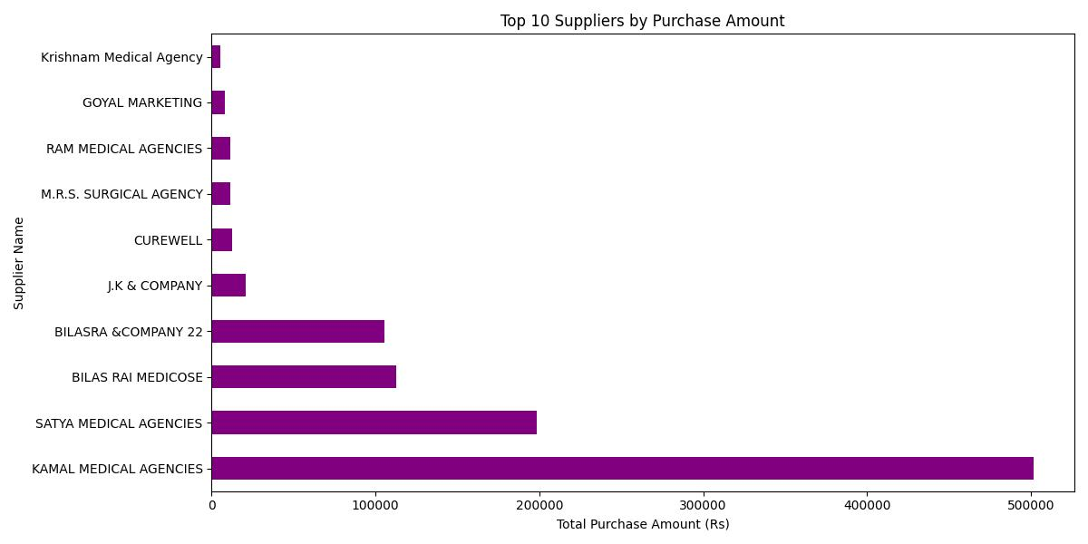
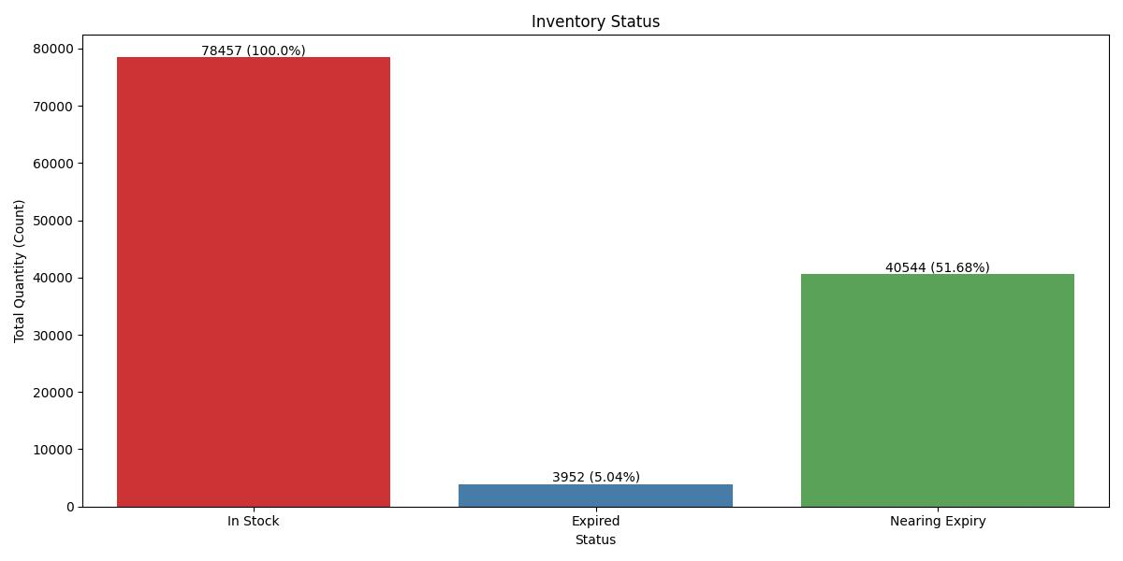
Results and Findings
1. Highlights suppliers contributing the most to the overall purchase amount. Kamal Medical Agencies was the most efficient supplier in terms of purchase amount. Higher purchase amount signifies that the supplier has maintained a good relationship with the owner.
2. shows the distribution of items in stock, expired, and nearing expiry. Approx 2952 Products have expired and 40544 products expiring in the next 3 months.

Slide 7
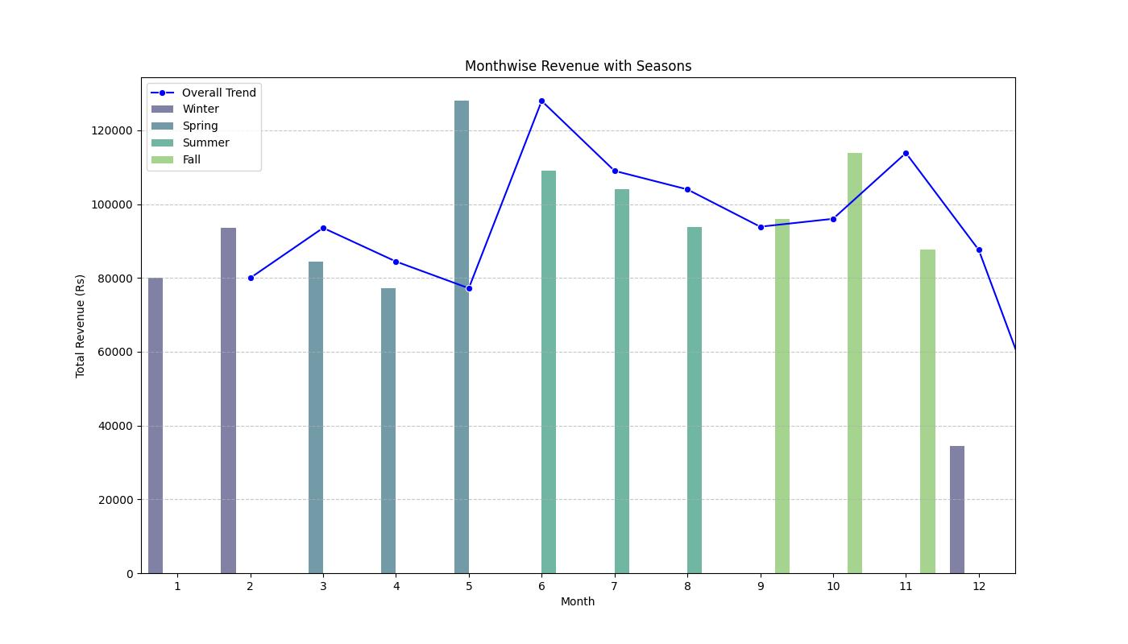
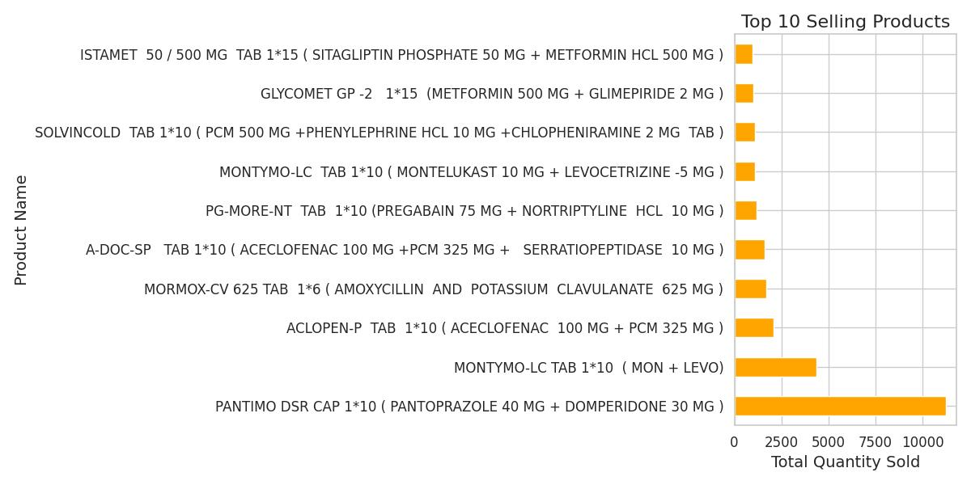
Results and Findings
3. Illustrates the revenue trend throughout the year with seasonal variations. Revenue peaked in the Spring season and in the month of May.
4. Identifies the products with the highest sales. Pantoprazole Tablet is the most selling product for the past year.

Slide 8
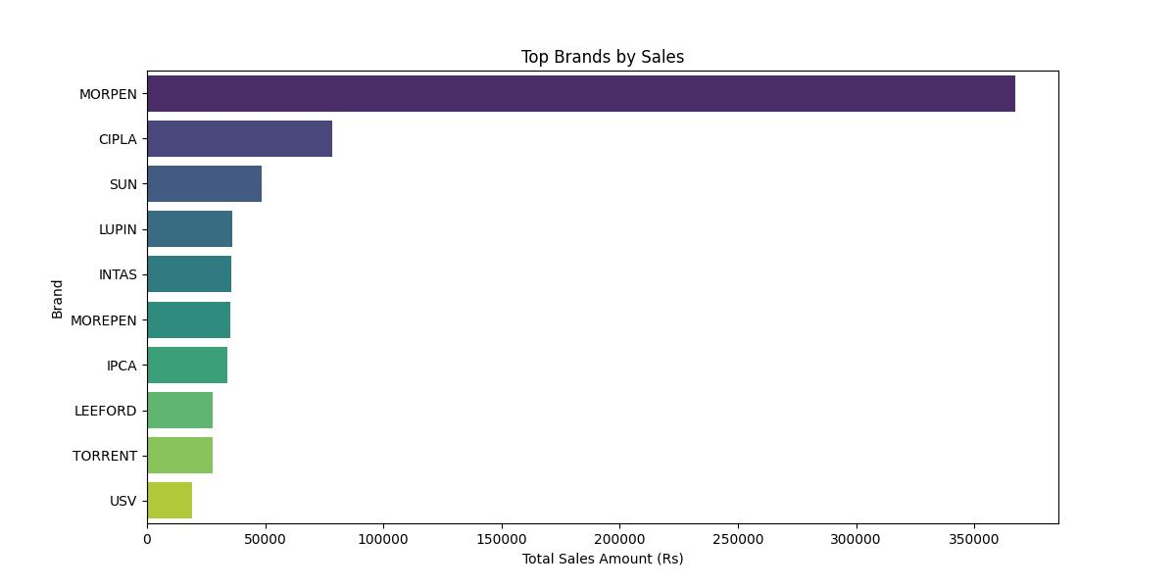
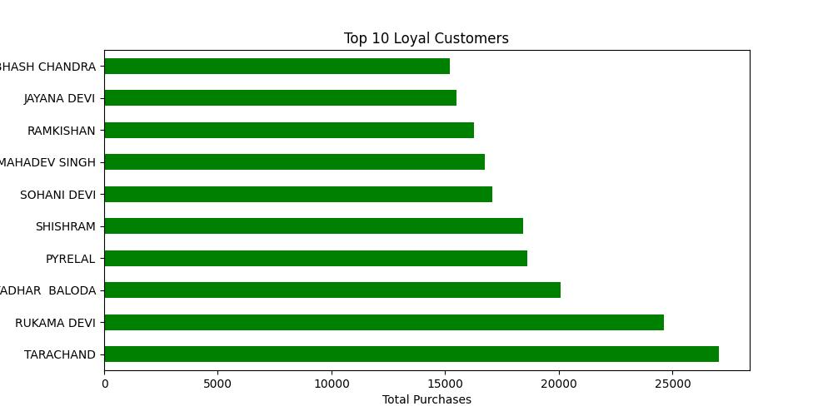
Results and Findings
5. The analysis reveals the brands that contribute the most to sales revenue. Among all brands, products from Morpen emerged as the top revenue generators..
6. The analysis highlights the top 10 loyal customers based on their purchase amounts.Tarachand emerges as the most loyal customer among all, indicating consistent and substantial purchases..

Slide 9
Recommendations
1. Supplier Relations: Strengthen ties with efficient suppliers like Kamal Medical Agencies for timely procurement. Negotiate favorable terms for mutual benefit.
2. Inventory Management: Implement robust inventory practices to address product expiration. Optimize stock levels and dispose of expired items promptly.
3. Seasonal Strategies: Tailor sales plans to seasonal revenue trends. Prepare for peak seasons such as Spring with adequate resources and inventory.
4. Product Focus: Promote top sellers like Pantoprazole Tablet for higher sales. Invest in targeted marketing and product enhancement.
5. Brand Enhancement: Utilize popular brands like Morpen for increased visibility. Collaborate with manufacturers for joint marketing efforts.
6. Customer Engagement: Reward loyal customers like Tarachand with personalized incentives. Enhance engagement through tailored communication and support.

Slide 10
Thank You !

